Slide 1
Java Reference - Part I
Adapted from Data Structures and Algorithms in Java, 6th edition, by M. T. Goodrich, R. Tamassia, and M. H. Goldwasser, Wiley, 2014

Slide 2
The Java Compiler
Java is a compiled language.
Programs are compiled into byte-code executable files, which are executed through the Java virtual machine (JVM).
The JVM reads each instruction and executes that instruction.
A programmer defines a Java program in advance and saves that program in a text file known as source code.
For Java, source code is conventionally stored in a file named with the .java suffix (e.g., demo.java) and the byte-code file is stored in a file named with a .class suffix, which is produced by the Java compiler.
Java Primer 1
2

Slide 3
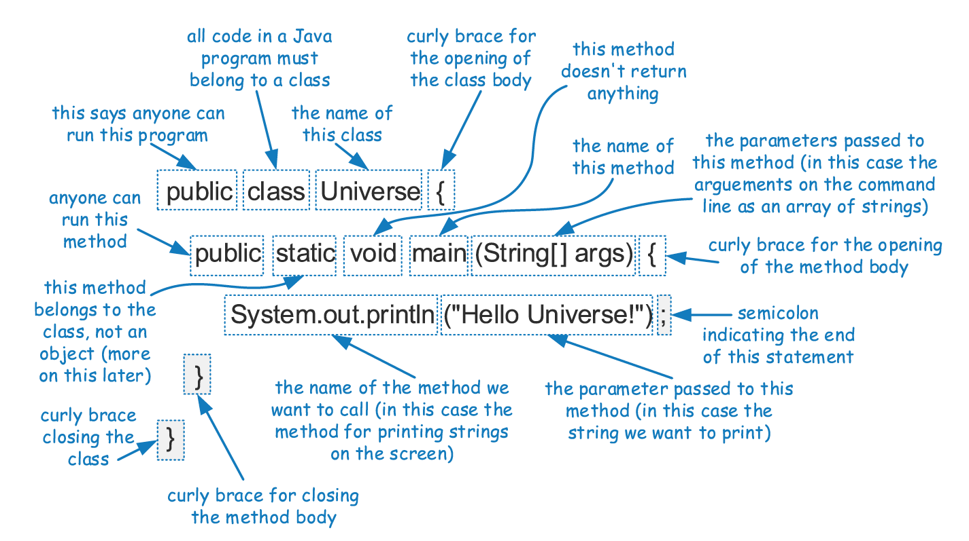
An Example Program
Java Primer 1
3

Slide 4
Components of a Java Program
In Java, executable statements are placed in functions, known as methods, that belong to class definitions.
The static method named main is the first method to be executed when running a Java program.
Any set of statements between the braces “{” and “}” define a program block.
Java Primer 1
4

Slide 5
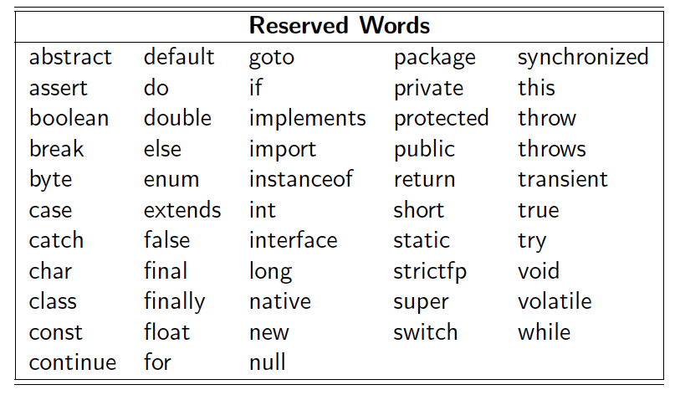
Identifiers
The name of a class, method, or variable in Java is called an identifier, which can be any string of characters as long as it begins with a letter and consists of letters.
Exceptions:
Java Primer 1
5

Slide 6
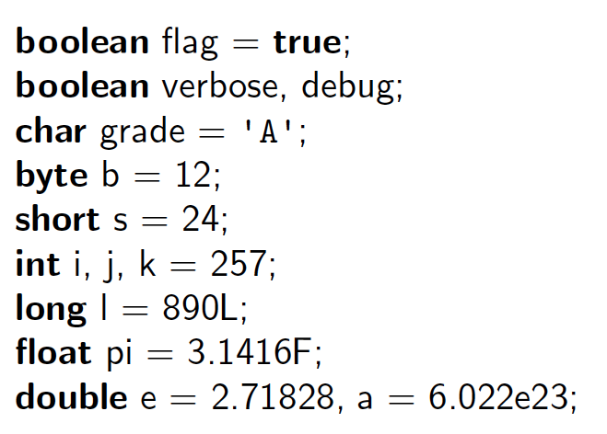
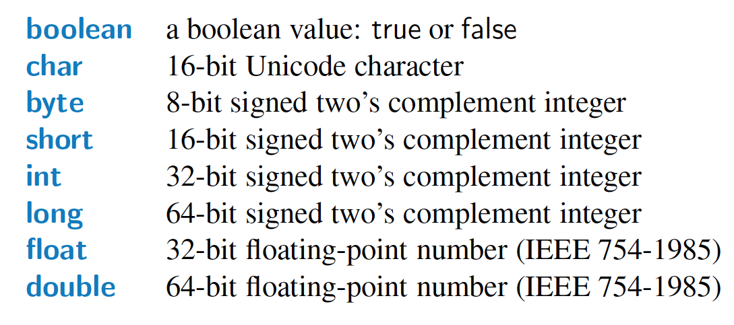
Base Types
Java has several base types, which are basic ways of storing data.
An identifier variable can be declared to hold any base type and it can later be reassigned to hold another value of the same type.
Java Primer 1
6

Slide 7
Classes and Objects
Every object is an instance of a class, which serves as the type of the object and as a blueprint, defining the data which the object stores and the methods for accessing and modifying that data. The critical members of a class in Java are the following:
Instance variables, which are also called fields, represent the data associated with an object of a class. Instance variables must have a type, which can either be a base type (such as int, float, or double) or any class type.
Methods in Java are blocks of code that can be called to perform actions. Methods can accept parameters as arguments, and their behavior may depend on the object upon which they are invoked and the values of any parameters that are passed. A method that returns information to the caller without changing any instance variables is known as an accessor method, while an update method is one that may change one or more instance variables when called.
Java Primer 1
7

Slide 8
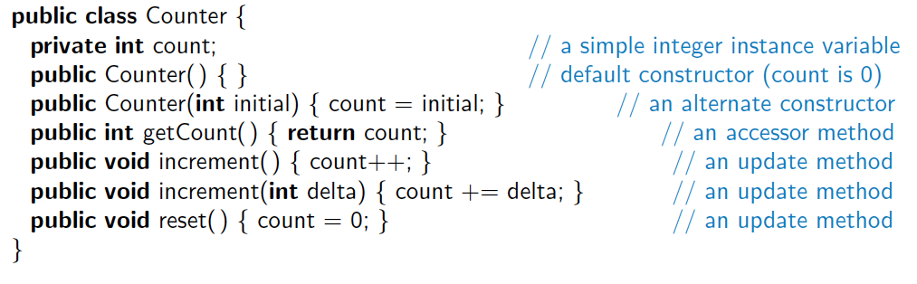
Another Example
This class includes one instance variable, named count, which will have a default value of zero, unless we otherwise initialize it.
The class includes two special methods known as constructors, one accessor method, and three update methods.
Java Primer 1
8

Slide 9
Creating and Using Objects
Classes are known as reference types in Java, and a variable of that type is known as a reference variable.
A reference variable is capable of storing the location (i.e., memory address) of an object from the declared class.
So we might assign it to reference an existing instance or a newly constructed instance.
A reference variable can also store a special value, null, that represents the lack of an object.
In Java, a new object is created by using the new operator followed by a call to a constructor for the desired class.
A constructor is a method that always shares the same name as its class. The new operator returns a reference to the newly created instance; the returned reference is typically assigned to a variable for further use.
9

Slide 10
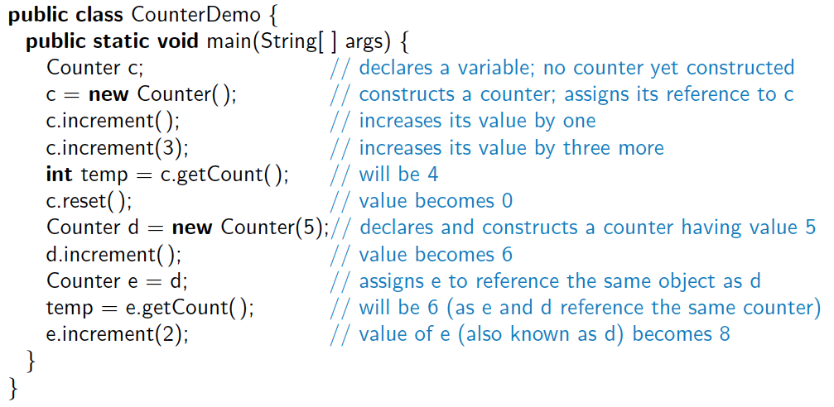
Continued Example
Here, a new Counter is constructed at line 4, with its reference assigned to the variable c. That relies on a form of the constructor, Counter( ), that takes no arguments between the parentheses.

Slide 11
The Dot Operator
One of the primary uses of an object reference variable is to access the members of the class for this object, an instance of its class.
This access is performed with the dot (“.”) operator.
We call a method associated with an object by using the reference variable name, following that by the dot operator and then the method name and its parameters.
Java Primer 1
11

Slide 12
Wrapper Types
There are many data structures and algorithms in Java’s libraries that are specifically designed so that they only work with object types (not primitives).
To get around this obstacle, Java defines a wrapper class for each base type.
Java provides additional support for implicitly converting between base types and their wrapper types through a process known as automatic boxing and unboxing.
Java Primer 1
12

Slide 13
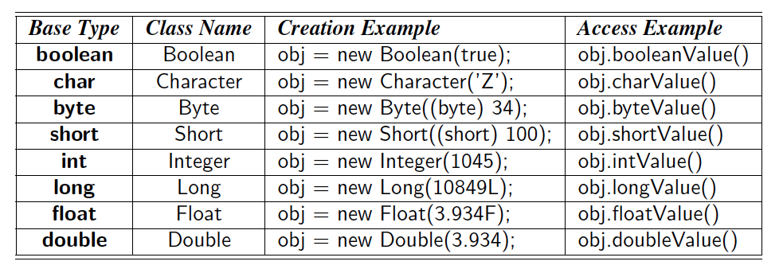
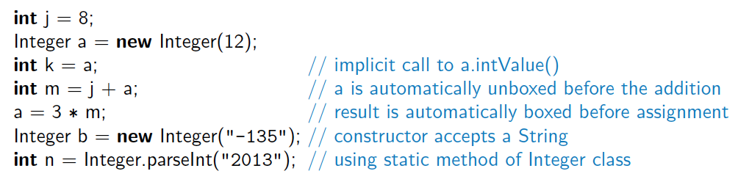
Example Wrapper Types
Java Primer 1
13

Slide 14
Signatures
If there are several methods with this same name defined for a class, then the Java runtime system uses the one that matches the actual number of parameters sent as arguments, as well as their respective types.
A method’s name combined with the number and types of its parameters is called a method’s signature, for it takes all of these parts to determine the actual method to perform for a certain method call.
A reference variable v can be viewed as a “pointer” to some object o.
Java Primer 1
14

Slide 15
Defining Classes
A class definition is a block of code, delimited by braces “{” and “}” , within which is included declarations of instance variables and methods that are the members of the class.
Immediately before the definition of a class, instance variable, or method in Java, keywords known as modifiers can be placed to convey additional stipulations about that definition.
Java Primer 1
15

Slide 16
Access Control Modifiers
The public class modifier designates that all classes may access the defined aspect.
The protected class modifier designates that access to the defined aspect is only granted to classes that are designated as subclasses of the given class through inheritance or in the same package.
The private class modifier designates that access to a defined member of a class be granted only to code within that class.
When a variable or method of a class is declared as static, it is associated with the class as a whole, rather than with each individual instance of that class.
Java Primer 1
16

Slide 17
Parameters
A method’s parameters are defined in a comma-separated list enclosed in parentheses after the name of the method.
A parameter consists of two parts, the parameter type and the parameter name.
If a method has no parameters, then only an empty pair of parentheses is used.
All parameters in Java are passed by value, that is, any time we pass a parameter to a method, a copy of that parameter is made for use within the method body.
So if we pass an int variable to a method, then that variable’s integer value is copied.
The method can change the copy but not the original.
If we pass an object reference as a parameter to a method, then the reference is copied as well.
Java Primer 1
17

Slide 18
The Keyword this
Within the body of a method in Java, the keyword this is automatically defined as a reference to the instance upon which the method was invoked. There are three common uses:
To store the reference in a variable, or send it as a parameter to another method that expects an instance of that type as an argument.
To differentiate between an instance variable and a local variable with the same name.
To allow one constructor body to invoke another constructor body.
Java Primer 1
18

Slide 19
Expressions and Operators
Existing values can be combined into expressions using special symbols and keywords known as operators.
The semantics of an operator depends upon the type of its operands.
For example, when a and b are numbers, the syntax a + b indicates addition, while if a and b are strings, the operator + indicates concatenation.
Java Primer 1
19

Slide 20
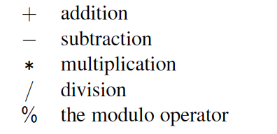
Arithmetic Operators
Java supports the following arithmetic operators:
If both operands have type int, then the result is an int; if one or both operands have type float, the result is a float.
Integer division has its result truncated.
Java Primer 1
20

Slide 21
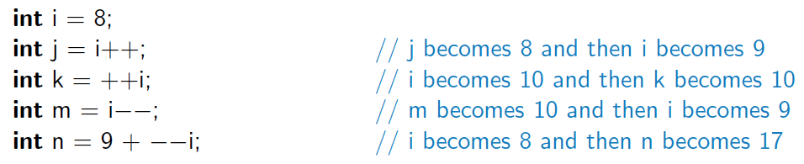
Increment and Decrement Ops
Java provides the plus-one increment (++) and decrement (−−) operators.
If such an operator is used in front of a variable reference, then 1 is added to (or subtracted from) the variable and its value is read into the expression.
If it is used after a variable reference, then the value is first read and then the variable is incremented or decremented by 1.
Java Primer 1
21

Slide 22
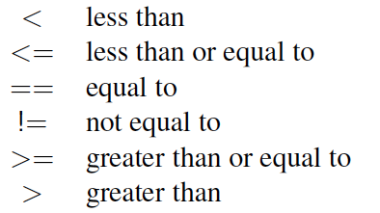
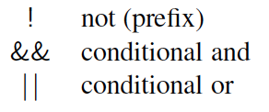
Logical Operators
Java supports the following operators for numerical values, which result in Boolean values:
Boolean values also have the following operators:
The and and or operators short circuit, in that they do not evaluate the second operand if the result can be determined based on the value of the first operand.
Java Primer 1
22

Slide 23
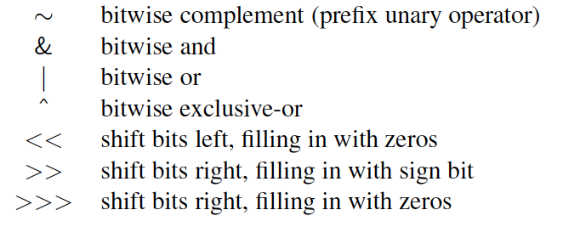
Bitwise Operators
Java provides the following bitwise operators for integers and booleans:
Java Primer 1
23

Slide 24
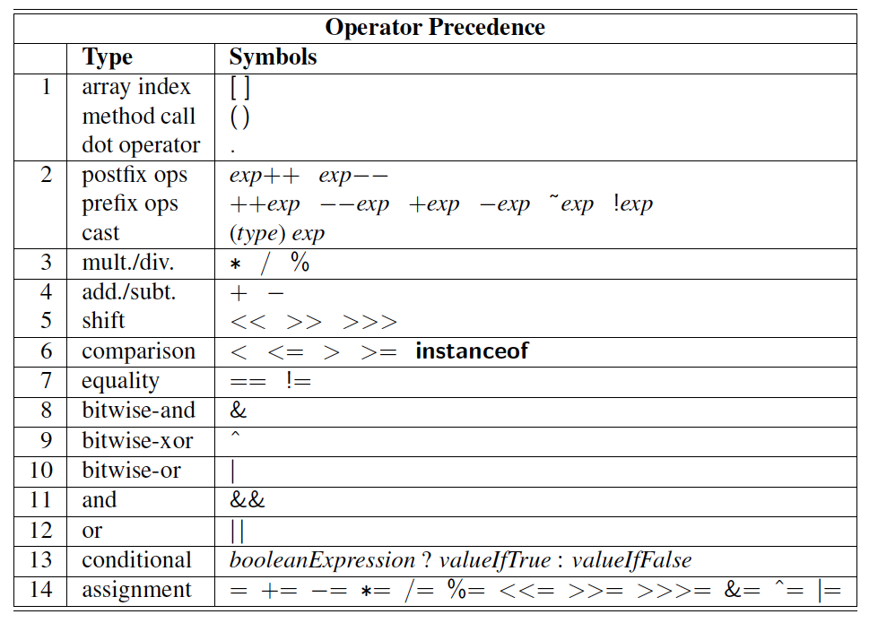
Operator Precedence

Slide 25
Casting
Casting is an operation that allows us to change the type of a value.
We can take a value of one type and cast it into an equivalent value of another type.
There are two forms of casting in Java: explicit casting and implicit casting.
Java Primer 1
25

Slide 26
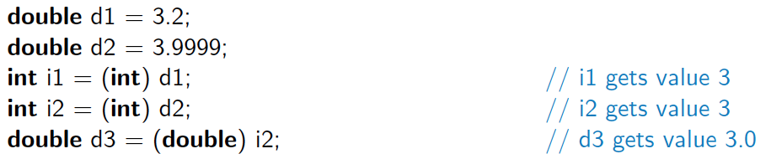
Explicit Casting
Java supports an explicit casting syntax with the following form:
(type) exp
Here “type” is the type that we would like the expression exp to have.
This syntax may only be used to cast from one primitive type to another primitive type, or from one reference type to another reference type.
Examples:
Java Primer 1
26

Slide 27
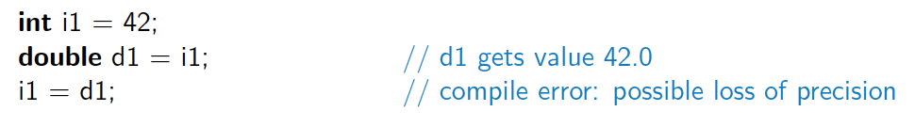
Implicit Casting
There are cases where Java will perform an implicit cast based upon the context of an expression.
You can perform a widening cast between primitive types (such as from an int to a double), without explicit use of the casting operator.
However, if attempting to do an implicit narrowing cast, a compiler error results.
Java Primer 1
27

Slide 28
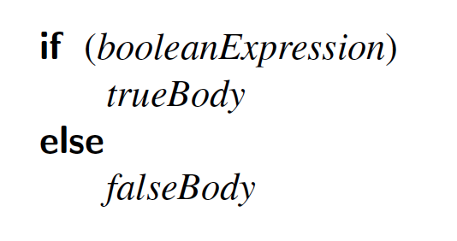
If Statements
The syntax of a simple if statement is as follows:
booleanExpression is a boolean expression and trueBody and falseBody are each either a single statement or a block of statements enclosed in braces (“{” and “}”).
Java Primer 2
28

Slide 29
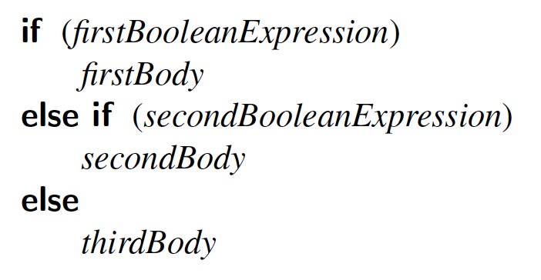
Compound if Statements
There is also a way to group a number of boolean tests, as follows:
Java Primer 2
29

Slide 30
Switch Statements
Java provides for multiple-value control flow using the switch statement.
The switch statement evaluates an integer, string, or enum expression and causes control flow to jump to the code location labeled with the value of this expression.
If there is no matching label, then control flow jumps to the location labeled “default.”
This is the only explicit jump performed by the switch statement, however, so flow of control “falls through” to the next case if the code for a case is not ended with a break statement
Java Primer 2
30

Slide 31
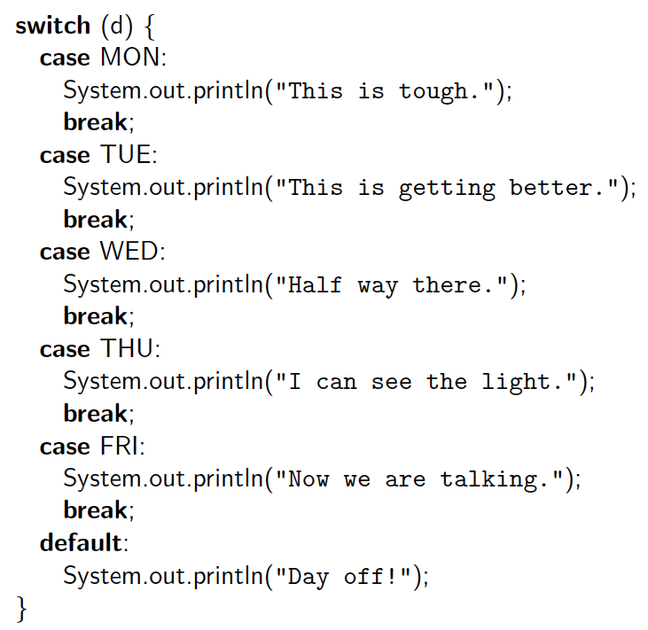
Switch Example

Slide 32
Break and Continue
Java supports a break statement that immediately terminate a while or for loop when executed within its body.
Java also supports a continue statement that causes the current iteration of a loop body to stop, but with subsequent passes of the loop proceeding as expected.
Java Primer 2
32

Slide 33
While Loops
The simplest kind of loop in Java is a while loop.
Such a loop tests that a certain condition is satisfied and will perform the body of the loop each time this condition is evaluated to be true.
The syntax for such a conditional test before a loop body is executed is as follows:
while (booleanExpression)
loopBody
Java Primer 2
33

Slide 34
Do-While Loops
Java has another form of the while loop that allows the boolean condition to be checked at the end of each pass of the loop rather than before each pass.
This form is known as a do-while loop, and has syntax shown below:
do
loopBody
while (booleanExpression)
Java Primer 2
34

Slide 35
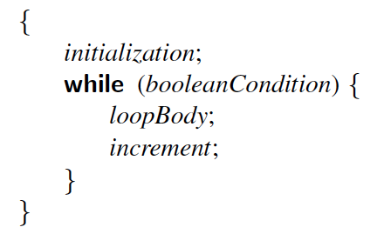
For Loops
The traditional for-loop syntax consists of four sections—an initialization, a boolean condition, an increment statement, and the body—although any of those can be empty.
The structure is as follows:
for (initialization; booleanCondition; increment)
loopBody
Meaning:
Java Primer 2
35

Slide 36
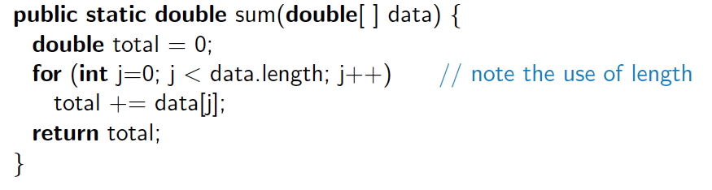
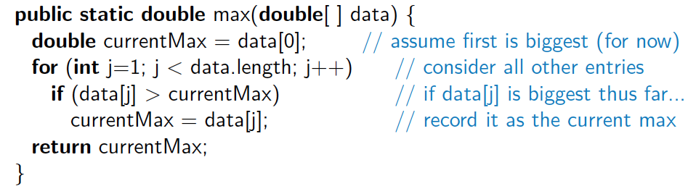
Example For Loops
Compute the sum of an array of doubles:
Compute the maximum in an array of doubles:
Java Primer 2
36

Slide 37
For-Each Loops
Since looping through elements of a collection is such a common construct, Java provides a shorthand notation for such loops, called the for-each loop.
The syntax for such a loop is as follows:
for (elementType name : container)
loopBody
Java Primer 2
37

Slide 38
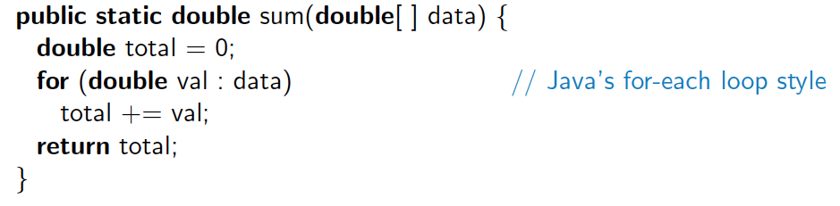
For-Each Loop Example
Computing a sum of an array of doubles:
When using a for-each loop, there is no explicit use of array indices.
The loop variable represents one particular element of the array.
Java Primer 2
38

Slide 39
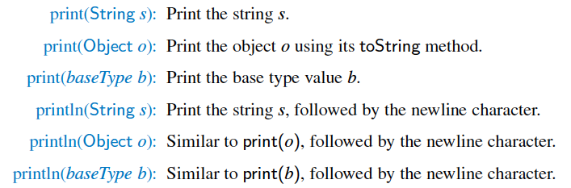
Simple Output
Java provides a built-in static object, called System.out, that performs output to the “standard output” device, with the following methods:
Java Primer 2
39

Slide 40
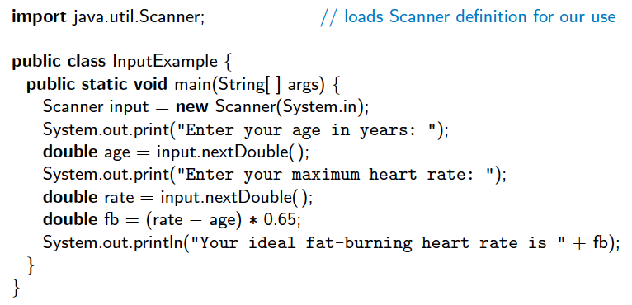
Simple Input
There is also a special object, System.in, for performing input from the Java console window.
A simple way of reading input with this object is to use it to create a Scanner object, using the expression
new Scanner(System.in)
Example:
Java Primer 2
40

Slide 41
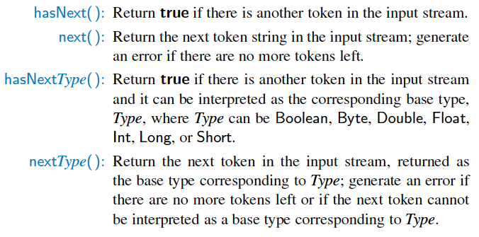
java.util.Scanner Methods
The Scanner class reads the input stream and divides it into tokens, which are strings of characters separated by delimiters.
Java Primer 2
41

Slide 42
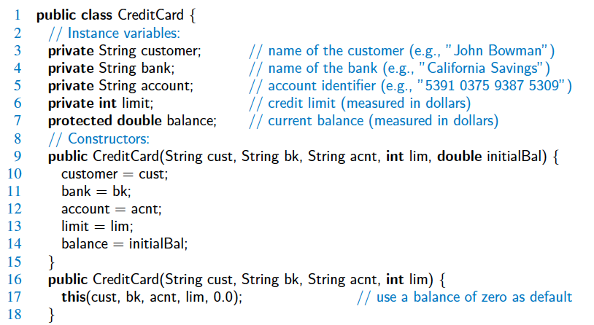
Sample Program

Slide 43
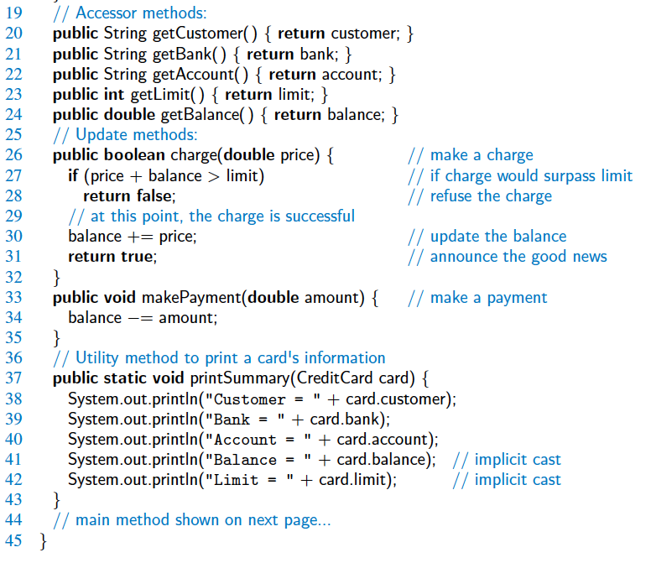
Sample Program

Slide 44
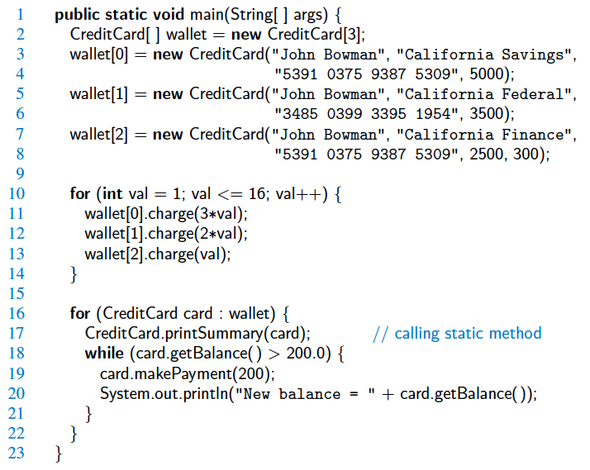
Sample Program

Slide 45
Exercise
You are required to write a Java program to calculate the fine amounts for a Library using the following rules:
If the book is returned on or before the due date, there is no fine (fine amount is 0).
If the book is returned after due date, the fine is $2 for each day late.
Keep in mind the followings:
Take return date input from user, e.g., day, month, year
You are required to use Actual Dates in Java.
Perform Date calculations to find difference between due date and return date
Look in to
java.util.Scanner
java.time.LocalDate
java.time.temporal.ChronoUnit
Java Primer 2
45

